Slide 1

Customer Shopping Behavior Analysis
Uncovering insights from 3,900 purchases to guide strategic business decisions

Slide 2
Dataset Overview
3,900
18
37
Purchase Records
Data Columns
Missing Values
Transactional data analyzed
Customer and purchase details
Review ratings imputed
Key Features
Analysis Tools
Customer demographics
Purchase details
Shopping behavior
Python for EDA
SQL for queries
Power BI dashboard

Slide 3
Python Data Preparation
01
02
03
Data Loading
Initial Exploration
Missing Data Handling
Imported dataset using pandas
Checked structure and summary statistics
Imputed missing values using median ratings
04
05
Feature Engineering
Database Integration
Created age groups and purchase frequency metrics
Loaded cleaned data into PostgreSQL

Slide 4

SQL Analysis: Revenue Insights
Revenue by Gender
Shipping Comparison
Male: $157,890
Female: $75,191
Standard: $58.46 avg
Express: $60.48 avg

Slide 5


Product Performance
Top Rated
Discount-Dependent
Gloves, Sandals, Boots lead ratings
Hats, Sneakers, Coats most discounted
Top Categories
Clothing ($100K), Accessories ($70K)

Slide 6
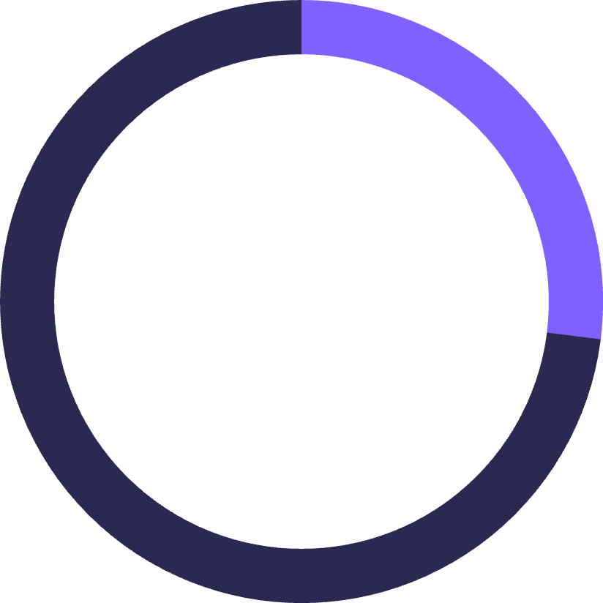

Subscription Analysis
27%
73%
Subscribers
Non-Subscribers
1,053 customers
2,847 customers
Average Spend
Total Revenue
Subscribers: $59.49
Non-subscribers: $59.87
Subscribers: $62,645
Non-subscribers: $170,436

Slide 7

Customer Segmentation
Loyal
Returning
3,116 customers with consistent purchases
701 customers with multiple visits
New
83 customers making first purchase

Slide 8
Revenue by Age Group
27%
25%
Young Adult
Middle-aged
$62,143 revenue
$59,197 revenue
24%
24%
Adult
Senior
$55,978 revenue
$55,763 revenue

Slide 9
Key Findings
Male Dominance
High-Value Discount Users
Male customers generate 2.1x more revenue than female customers
839 customers used discounts but spent above average purchase amount
Repeat Buyer Subscriptions
Category Performance
958 repeat buyers (over 5 purchases) subscribed to membership
Clothing drives 45% of revenue with 1,800 sales; Outerwear has highest per-unit value

Slide 10





Strategic Recommendations
Boost Subscriptions
Promote exclusive benefits
Customer Loyalty Programs
Reward repeat buyers
Review Discount Policy
Balance sales with margins
Targeted Marketing
Focus on high-revenue segments

